Slide 1
Characteristics of wireless networks

Slide 2
Characteristics of Wireless Transmissions
Wireless networks (WLANs) are networks that transmit signals through the air via RF (radio frequency) waves
Wired and wireless signals share many similarities including the use of the same Layer 3 and higher protocols
The nature of the atmosphere makes wireless transmission different from wired transmission

Slide 3
The Wireless Spectrum (1 of 6)
The wireless spectrum is the frequency range of electromagnetic waves used for data and voice communication
The wireless spectrum spans frequency ranges or bands between 9 kHz and 300 GHz
Some bands have only a single frequency (called a fixed frequency) for that band

Slide 4
The Wireless Spectrum (1 of 6)
RFID (Radio Frequency Identification) uses electromagnetic fields to store data on a small chip in an RFID tag, which includes an antenna that can transmit and receive, and possibly a battery
RFID is commonly used for inventory management
NFC (near-field communication) is a form of RFID that transfers data wirelessly over very short distances
Signal can be transmitted one way by an NFC tag, or smart tag
The NFC tag collects power from the smartphone or other device by magnetic induction

Slide 5
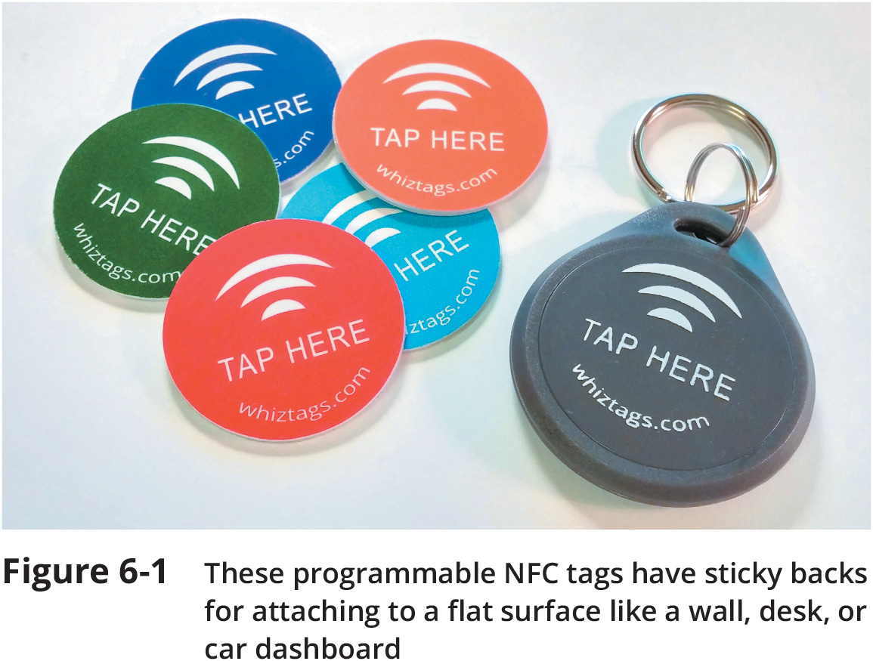
The Wireless Spectrum (2 of 6)

Slide 6
The Wireless Spectrum (3 of 6)
Z-Wave is a smart home protocol that provides two basic types of functions:
Signaling to manage wireless connections and control to transmit data and commands between devices
A Z-Wave network controller (called a hub) receives commands from a smartphone or computer and relays the commands to various smart devices on its network

Slide 7
The Wireless Spectrum (3 of 6)
ZigBee is a low-powered, battery-conserving wireless technology
It is designed to handle small amounts of data
Zigbee is used in IoT devices for purposes such as building automation, HVAC control, AMR (Automatic Meter Reading), and fleet management

Slide 8
The Wireless Spectrum (4 of 6)
Bluetooth technology unites separate entities under a single communication standard
Bluetooth hops between frequencies within that band to help reduce interference
Most Bluetooth devices require close proximity to form a connection, with the exact distance requirements depending on the class of Bluetooth device

Slide 9
The Wireless Spectrum (4 of 6)
ANT+ technology is based on the ANT protocol, which is an ad-hoc wireless protocol operating at about 2.4 GHz
ANT+ gathers and tracks information from sensors typically embedded in heart rate monitors, GPS devices, and other activity monitoring devices
ANT+ can also sync data from multiple devices for the same activity
Such as a smartwatch, smartphone, bicycle computer, or fitness equipment

Slide 10
The Wireless Spectrum (5 of 6)
IR (infrared) technology is used primarily to collect data through various sensors
IR exists just below the spectrum visible to the human eye
IR sensors are used to collect information such as the following:
Presence or level of liquid
Variations in reflections from skin caused by variations in blood flow
Proximity to the device
Commands from a control device

Slide 11
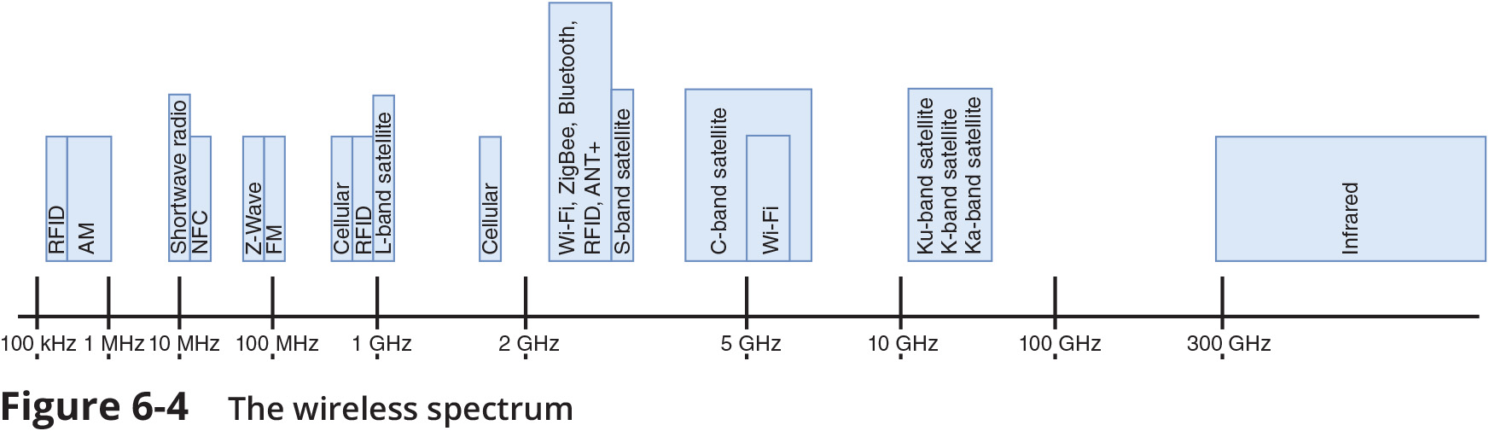
The Wireless Spectrum (6 of 6)

Slide 12
Channel Management
Most wireless devices implement one of two technologies:
FHSS (frequency hopping spread spectrum)
DSSS (direct sequence spread spectrum)
How each wireless standard in the 2.4 GHz range uses its allotted band:
Wi-Fi uses DSSS
Bluetooth uses FHSS
ZigBee uses DSSS

Slide 13
Antennas
Wireless signals originate from electrical current traveling along a conductor
The electrical signal travels from the transmitter to an antenna, which then emits the signal as a series of electromagnetic waves into the atmosphere
At the destination, another antenna accepts the signal and a receiver converts it back to current
Two antennas must be tuned to the same frequency in order to use the same channel

Slide 14
Antennas
An antenna’s radiation pattern describes the relative strength over a three-dimensional area of all electromagnetic energy that antenna sends or receives
Directional (unidirectional) antenna – Issues wireless signals along a single direction
Omnidirectional antenna – Issues and receives wireless signals with equal strength, clarity in all directions
The geographical area that an antenna can reach is known as its range

Slide 15
Signal Propagation (1 of 4)
Propagation refers to the way in which a wave travels from one point to another
LOS (line-of-sight) occurs when the signal travels in a straight line directly from transmitter to receiver
Wireless signals do not usually follow a straight line
When obstacles are in a signal’s way, the signal may:
Pass through the object
Be absorbed by the object

Slide 16
Signal Propagation (2 of 4)
Attenuation – the farther the signal moves away from the transmission source, the more it weakens
Wireless signals can be amplified by increasing the power of the transmission or extended by repeating the signal from a closer broadcast point called a wireless range extender

Slide 17
Signal Propagation (2 of 4)
Fading – as a signal runs into obstacles, its energy will gradually fade
Excessive fading can cause dropped connections or slow data transmission
Interference – electromagnetic waves can interfere with wireless communications
Wireless signals are more vulnerable to noise
Signal-to-noise ratio (SNR) is the proportion of noise to the strength of a signal

Slide 18
Signal Propagation (3 of 4)
Refraction – as a wave travels through objects the wave’s direction, speed, and wavelength are altered (or refracted)
Reflection – the wave encounters an obstacle and reflects, or bounces back toward its source
Scattering – when a wireless signal encounters an object that has small surface dimensions compared with the signal’s wavelength, it’s diffused or scattered in multiple directions
Diffraction – a wireless signal is diffracted, or split into secondary waves, when it encounters an obstruction
Wireless signals follow different paths to destination, known as multipath signals

Slide 19
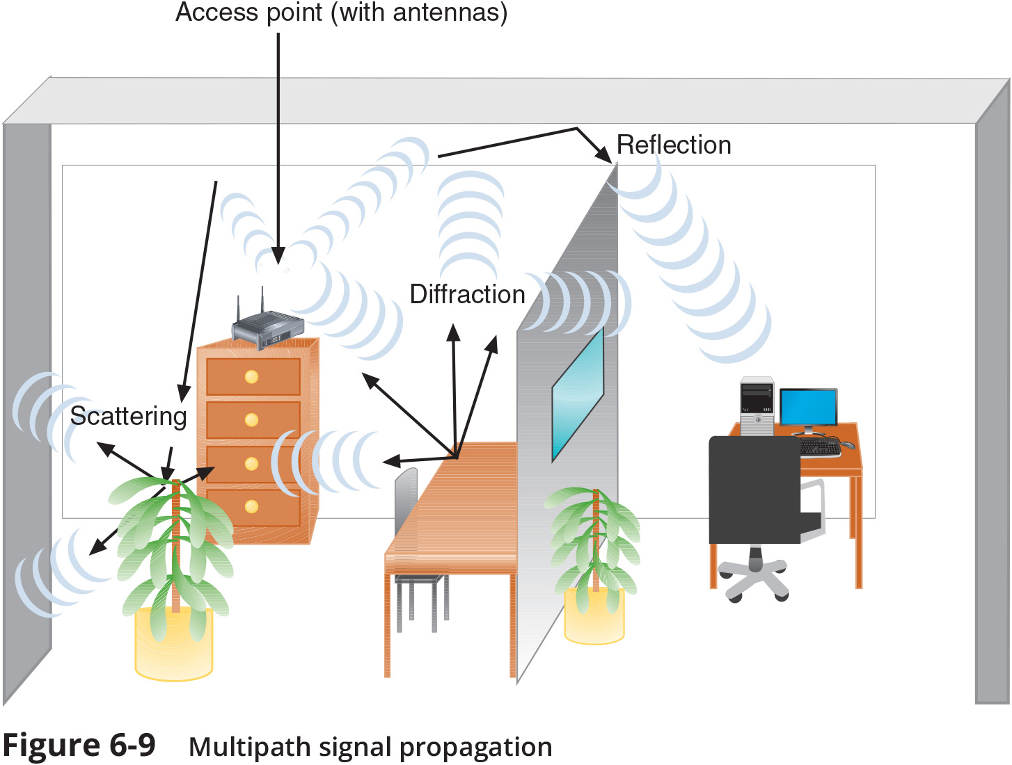
Signal Propagation (4 of 4)

